Slide 1
Hillier Building Applications for Office 365 and SharePoint with Angular 2

Slide 2








www.itunity.com/users/scot-hillier
www.criticalpathtraining.com
scot@scothillier.net
@ScotHillier
www.microsoftvirtualacademy.com/Studies/SearchResult.aspx?q=hillier
channel9.msdn.com/Search?term=hillier#ch9Search
www.pluralsight.com/search/?searchTerm=hillier

Slide 3
Agenda
Enterprise JavaScript
Overview and Development Environment
Classes and Modules
TypeScript
Angular 2 Framework
Fundamentals
Observables
SharePoint Framework
Overview and Development Environment
Client Web Part Basics
Angular 2 Development

Slide 4
Enterprise javascript
Overview and Development Environment

Slide 5
Overview
Environments
Visual Studio 2015, Update 3
Visual Studio Code
Tools and Technologies
Node JS
Node Package Manager (NPM)
Gulp
TypeScript
Project Types
Node
ASP.NET MVC
ASP.NET Core
SharePoint Add-Ins
SharePoint Framework

Slide 6
Development Environment
Visual Studio
Update 3 and ASP.NET Core 1.0
https://go.microsoft.com/fwlink/?LinkId=691129
TypeScript 2.0 beta npm install -g typescript@beta
Node.js Tools for Visual Studio https://beta.visualstudio.com/vs/node-js
Node
Node.js 5.3.0 https://nodejs.org/en/
Node Package Manager Windows Upgrade npm install -g npm-windows-upgrade
npm-windows-upgrade

Slide 7
DEMO
Key Tools and Resources

Slide 8
Enterprise JavaScript
Classes and Modules

Slide 9
ECMAScript 2015
Compatibility
Varying levels of support
https://kangax.github.io/compat-table/es6/
Features
http://es6-features.org
arrows | classes | enhanced object Literals | template literals
destructuring | default, rest, spread | let, const | iterators
generators | unicode | modules, loaders | map, set
proxies | symbols | built-ins | promises
object APIs | literals | reflection | tail calls
Notes:
Show that browser support lags JavaScript editions
We have historically used polyfills to bridge the gaps
Show the ES2015 feature set just to prove it’s worth using the features now

Slide 10
Classes
class person {
constructor(firstName, lastName) {
this.firstName = firstName;
this.lastName = lastName;
}
speak() {
return `My name is ${this.firstName} ${this.lastName}.`;
}
}
var p = new person('Scot', 'Hillier');
alert(p.speak());
Notes:
Shows a class, constructor, instantiation and string interpolation

Slide 11
Inheritance
class customer extends person {
constructor(firstName, lastName, title, company, email) {
super(firstName, lastName)
this.title = title;
this.company = company;
this.email = email;
}
talk() {
return `${super.speak()} I work for ${this.company}.`;
}
}
var c = new customer('Scot', 'Hillier', 'MVP',
'IT Unity', 'scot@scothillier.net');
alert(c.talk());
Notes:
Extending the previous class

Slide 12
Modules
Internal
Used to encapsulate code
Prevents global namespace pollution
Loaded through a Script tag
External
Small units of independent, reusable code
Supports the pattern of “component” development
Loaded using an async module loader component
Notes:
The history of modules moving from functions to internal modules to external modules

Slide 13
Using the Revealing Module Pattern
Internal Module
//namespace
var Wingtip = window.Wingtip || {};
Wingtip.Customer = function () {
//private members
var name,
setname = function (n) { name = n; },
getname = function () { return name; },
talk = function () { alert("My name is " + name); };
//public interface
return {
set_name: setname,
get_name: getname,
speak: talk
}
}();
Wingtip.Customer.speak();
Notes:
Namespace
Revealing module pattern
Usage

Slide 14
External Modules
ES2015 Modules
Supports export/import without polluting global namespace
Current ECMAScript 5 support
CommonJS format used with node.js server
AMD format with require.js in browser
UMD format is compatible with AMD, CommonJS and no loader at all
JavaScript Loader standard
Attempting to standardize loading behavior
WebPack
Bundles modules and dependencies
Notes:
The point here is that the community has created these different loaders, but nothing that is standardized
The JavaScript loader standard was separated from ES2015 and is still in progress
ES2015 is the first time that JavaScript has the concept of modules built into the language. That’s really the idea – to get away from ad-hoc frameworks

Slide 15
ES2015 Declarative module usage
//requires a transpiler or polyfill today
//person.js
export class Person {
constructor(firstName, lastName) {
this.firstName = firstName;
this.lastName = lastName;
}
}
//app.js
import {Person} from 'person';
let p = new Person();

Slide 16
ES2015 dynamic module loading
//requires a transpiler or polyfill today
//person.js
export class Person {
constructor(firstName, lastName) {
this.firstName = firstName;
this.lastName = lastName;
}
}
//app.js
System.import('person').then(Person => {
let p = new Person();
}).catch(error => {
alert(error);
});

Slide 17
AMD modules with require.js
//index.html
<script src="/Scripts/require.js" data-main="/Scripts/app"></script>
//app.js
define(["require", "exports", "customer"], function (customer) {
alert(customer.speak());
});
//customer.js
define(["require", "exports"], function (require, exports) {
var Customer = (function () {
function Customer(fn, ln) {
this.firstName = fn;
this.lastName = ln;
}
Customer.prototype.speak = function () {
return "My name is " + this.firstName + " " + this.lastName;
};
return Customer;
})();
exports.Customer = Customer;
});

Slide 18
ES2015 module loader polyfill
<script src="traceur.js"></script>
<script src="es6-module-loader-dev.js"></script>
<!-- type="module" invokes the Google traceur transpiler on that code -->
<!-- System.import support is provided by the es6-module-loader -->
<script type="module">
System.import('app/module1.js').then(function (module1) {
let p = module1.Person('Scot', 'Hillier');
alert(p.speak());
}).catch(function (err) {
alert(err);
});
</script>

Slide 19
Register modules with system.js
<script src="system.js"></script>
<!–- built on top of the es6-module-loader polyfill -->
<!–- loads any module format, invokes transpiler if necessary -->
<script>
System.config({
packages: {
'app': {
format: 'register',
defaultExtension: 'js'
}
}
});
System.import('app/myModule')
.then(null, console.error.bind(console));
</script>

Slide 20
Bundle Modules with WebPack
//message.js
module.exports = "Hello, webpack!";
//content.js
module.exports = "<p style='color:blue'>" +
require("./message.js") + "</p>";
//server.js
var http = require('http');
var port = process.env.port || 1337;
http.createServer(function (req, res) {
res.writeHead(200, { 'Content-Type': 'text/html' });
res.end(require('./content.js'));
}).listen(port);
webpack ./server.js bundle.js
bundle.js
Notes:
Webpack bundles modules together into static resources

Slide 21
DEMO
Classes and Modules

Slide 22
Enterprise JavaScript
TypeScript

Slide 23
Introduction to TypeScript
Typed superset that transpiles to plain JavaScript
You write .ts files and it compiles to .js files
Cross-browser compatible
Integrated into Visual Studio 2015
Compilation
Intellisense
Key Features
Static typing
Classes, constructors, properties, methods
Modules
Interfaces

Slide 24
Static Typing
private getQueryStringParameter(p: string): string { ... };
scope
Input type
Return type
private displayName: string = "Scot";
Supported Types
boolean
number
string
Array<T>
enum
any
void
scope
type

Slide 25
Classes
class Welcome {
//private members
private displayName: string = "Scot Hillier";
private pictureUrl: string = "/images/sh.jpg";
//public methods
public get_viewModel() {
return {
"pictureUrl": this.pictureUrl,
"displayName": this.displayName
};
}
}

Slide 26
Interfaces
interface WelcomeData {
pictureUrl: string;
displayName: string;
}
class Welcome {
public get_viewModel(): WelcomeData {
return {
"pictureUrl": this.pictureUrl,
"displayName": this.displayName
};
}
}
Define Interface
Implement Interface

Slide 27
Internal Modules
//define module
module Wingtip {
export class Welcome {
private displayName: string = "Scot Hillier";
private pictureUrl: string = "/images/sh.jpg";
public get_viewModel() {
return {
"pictureUrl": this.pictureUrl,
"displayName": this.displayName
};
}
}
}
//use module
var vm = new Wingtip.Welcome();

Slide 28
External Modules
//wingtip.ts
export module Wingtip {
export class Welcome {
private displayName: string = "Scot Hillier";
private pictureUrl: string = "/images/sh.jpg";
public get_viewModel() {
return {
"pictureUrl": this.pictureUrl,
"displayName": this.displayName
};
}
}
}
//app.ts
import {Wingtip} from 'wingtip'
var vm = new Wingtip.Welcome();

Slide 29
Type Definition Files
Supports the use of external libraries
Provides intellisense in TypeScript environment
Takes the form of a *.d.ts file
Available “typings” NPM package
npm install typings –global
typings install sharepoint –ambient --save

Slide 30
DEMO
TypeScript Modules

Slide 31
Angular 2 Framework
Fundamentals

Slide 32
Introducing Angular 2
Description
Single-Page Application (SPA) Framework
Implements MV* (pronounced M-V-star) Pattern
Why Angular
True framework instead of patchwork of libraries
Strong separation of concerns
Why Angular 2
Significant improvements in speed
Supports latest JavaScript innovations like components, modules
Better mobile support

Slide 33
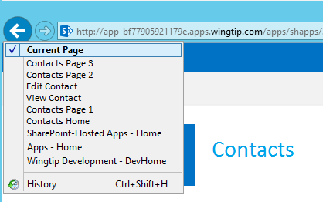
Single-Page Applications
App has one page
Different views are loaded dynamically
Routes are used to simulate pages
History list reflects route navigation
Id
First Name
Last Name
Id
1
First Name
Scot
Contacts.html
Last Name
Hillier

Slide 34
MV* with Angular 2
View
Component
Data
Model

Slide 35
Angular Building Blocks
Modules and Barrels
Components and Directives
Templates and Binding
Services and Dependency Injection

Slide 36
Modules and Barrels
//module
export class Welcome {
public static getMessage() {
return 'Hello, World!';
}
}
custom module
import module
//component
import {Welcome} from './app.module'
import {Component} from '@angular/core'
Import barrel

Slide 37
Components and Directives
import {Welcome} from './app.module'
import {Component} from '@angular/core'
@Component({
selector: 'app-main',
template: `<h1>${Welcome.getMessage()}</h1>`
})
export class AppComponent { }
Component associates HTML template with CSS selector
<tr *ngFor="let item of items">
<td>{{item.Title}}</td>
<td>{{item.Body}}</td>
</tr>
Structural directive adds elements to DOM
Attribute directive alters existing elements
<div [(ngModel)]="welcomeMessage"></div>

Slide 38
Important Built-in Directives
ngModel: binds component data to view
ngFor: for-each loop data binding
ngIf: conditional data binding
ngSwitch: switch-case data binding
ngStyle, ngClass: styles an HTML element

Slide 39
DEMO
Hello, Angular 2
Notes:
Build by hand
Then embedded in O365

Slide 40
Templates and Binding
<!-- interpolation -->
<div>{{welcomeMessage}}</div>
<!-- property binding -->
<button [disabled]="isWorking"></button>
<!-- event binding -->
<button (click)="buttonClicked()"></button>
<!-- two-way binding -->
<input [(ngModel)]="firstName"/>
<!-- directives -->
<div [ngClass]="setClasses()">{{author}}</div>
<my-directive [myProperty]="'an expression'"></my-directive>
<!-- attribute binding -->
<button [attr.aria-label]="actionName">Aria</button>

Slide 41
Services and Dependency Injection
export class SimpleService {
constructor() { }
getMessage() { return "Hi!"; }
}
Create the service
import {Component} from ‘@angular/core'
import {SimpleService} from './simple.service'
@Component({
templateUrl: '/app/templates/simple.html',
providers: [SimpleService]
})
export class SimpleComponent {
welcomeMessage: string;
constructor(simpleService: SimpleService) {
this.welcomeMessage = simpleService.getMessage();
}}
Inject the service

Slide 42
DEMO
Services and Dependency Injection
Notes:
Simple service

Slide 43
Angular 2 Framework
Observables

Slide 44
Observables
Support asynchronous operations
Define callback function with observer
Client subscribe to the Observable
Supports sequential and parallel operations
Angular Http returns an Observable
Interpolations can be assigned Observables

Slide 45
Custom Service
import {Observable} from 'rxjs/Observable'
import {Observer} from 'rxjs/Observer'
export class MyService {
constructor() {}
getData(): Observable<string> {
return Observable.create(observer => {
try {
observer.next('emit a value');
observer.complete();
}
catch (err) { observer.error(err); }
return function () {
//disposal function
}
});
}

Slide 46
Custom Consumer
@Component({
providers: [MyService]
})
export class MyComponent {
myService: MyService;
subscription: Subscription<string>;
constructor(ms: MyService) { this.myService = ms; }
subscribeToService() {
this.subscription = this.myService.getData().subscribe(
data => { console.log(data); },
err => { console.error(err); },
() => { console.info('completed'); }
);
}
cancelSubscription() { this.subscription.unsubscribe(); }
}

Slide 47
HTTP Service
import {Injectable} from ‘@angular/core'
import {Http, Headers, Response} from ‘@angular/http'
@Injectable()
export class ProductService {
httpService: Http;
constructor(http: Http) {
this.httpService = http;
}
getProducts(): Observable<any> {
return this.httpService.get("http://services.odata.org/.../Northwind.svc/Products", {
headers: new Headers({
"Accept": "application/json"
})
});
}
}

Slide 48
DEMO
Observables
Notes:
First observable demo
Then embedded demo
Then site page demo
Then SharePoint Hosted app

Slide 49
SharePoint framework
Overview and Development Environment

Slide 50
SharePoint Development Models
Full-Trust Code
Sandboxed Solutions
App/Add-In Model
Embedded JavaScript
SharePoint Framework

Slide 51
Development Environment
Office 365 Tenancy
Office Developer Program
App Catalog Developer Site Collection
Upload SharePoint Workbench
Visual Studio 2015
Complete previous setup steps Yeoman Generator, Gulp, and SharePoint Generator
npm install -g yo gulp
npm i -g @microsoft/generator-sharepoint

Slide 52
SharePoint framework
Client Web Part Basics

Slide 53
SharePoint Framework
Open source client-side UX
Responsive and mobile
Supports any JavaScript framework

Slide 54
Key Concepts
Codifies the JavaScript embed pattern
Runs in the context of the current user
Hosted in a referenced CDN
Works with new page experience or classic page experience

Slide 55
Development Flow
Generate Scaffolding
Package
Write Code
Deploy to CDN
Test in local Workbench
Upload to App Catalog
Test in SP Workbench
App Web Part to Page

Slide 56
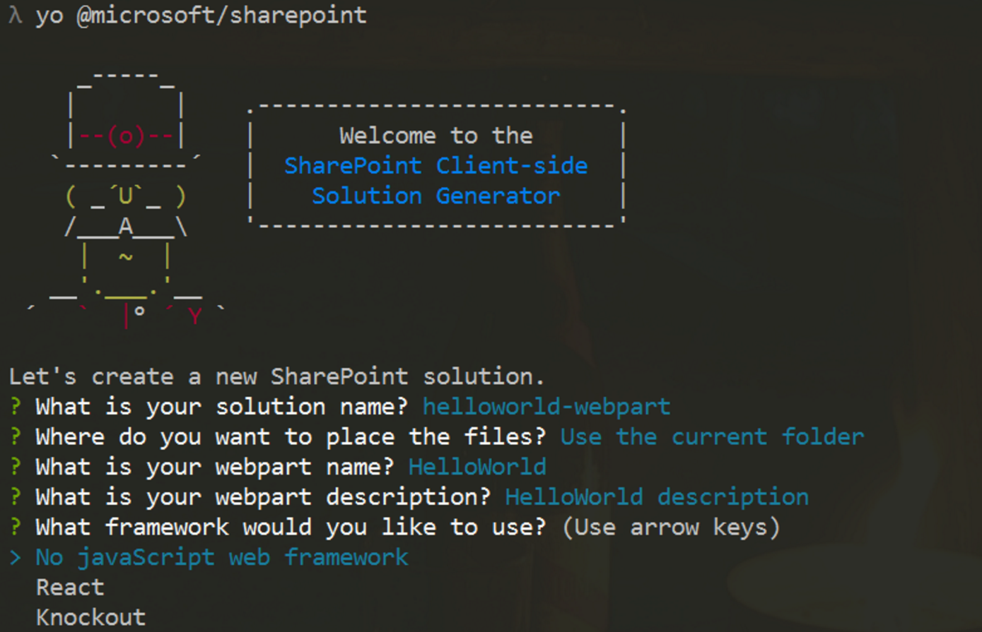
Generate Scaffolding
Yeoman Generator
Creates initial project files
React and KO built-in
Angular 2 requires manual steps
yo @microsoft/sharepoint
Visual Studio 2015
Open created project for editing

Slide 57
Write Code
export default class MyFirstKoWebPartWebPart extends
BaseClientSideWebPart<IMyFirstKoWebPartWebPartProps> {}
public render(): void {
}

Slide 58
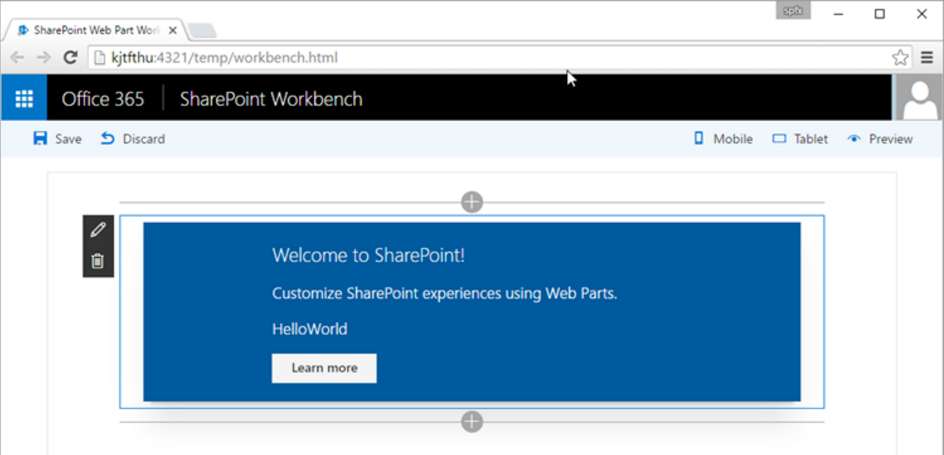
Test in Workbench
Local
For local testing
Office 365
Runs in the SharePoint context

Slide 59
Deployment
CDN Support
gulp package-solution
Deploy assets to CDN from directory in prepare-deploy.json file
Reference in write-manifests.json file
SharePoint
Create SPAPP package
Upload to App Catalog
Add to App and Web Part to site
"deployCdnPath": "temp/deploy"
"cdnBasePath": "https://[MYOFFICE365].sharepoint.com/SiteAssets/"

Slide 60
DEMO
Client Web Parts Basics
Notes:
Create a client web part with no framework
Run in local workbench
Run in Office 365 workbench

Slide 61
SharePoint framework
Angular 2 Development

Slide 62
Component
import { Component } from '@angular/core';
@Component({
selector: 'app-main',
template: '<h1>Hello, Angular 2 and SPFx!</h1>'
})
export class AppComponent { }

Slide 63
Module
import { NgModule } from '@angular/core';
import { BrowserModule } from '@angular/platform-browser';
import { AppComponent } from './app.component';
@NgModule({
imports: [BrowserModule],
declarations: [AppComponent],
bootstrap: [AppComponent]
})
export class AppModule { }

Slide 64
Coding the Web Part Class
export default class MyFirstNgWebPartWebPart
extends BaseClientSideWebPart<IMyFirstNgWebPartWebPartProps> {
public constructor(context: IWebPartContext) {
super(context);
//inject the app element
const appElement: HTMLElement = document.createElement('app-main');
this.domElement.appendChild(appElement);
}
public render(): void {
//bootstrap the module
const platform = platformBrowserDynamic();
platform.bootstrapModule(AppModule);
}
}

Slide 65
Configuration
"externals": {
"@microsoft/sp-client-base": "node_modules/@microsoft/sp-client-base/dist/sp-client-base.js",
"@microsoft/sp-client-preview": "node_modules/@microsoft/sp-client-preview/dist/sp-client-preview.js",
"rxjs/Subject": "node_modules/rxjs/bundles/rx.umd.js",
"rxjs/Observable": "node_modules/rxjs/bundles/rx.umd.js",
"@angular/compiler": "node_modules/@angular/compiler/bundles/compiler.umd.js",
"@angular/common": "node_modules/@angular/common/bundles/common.umd.js",
"@angular/core": "node_modules/@angular/core/bundles/core.umd.js",
"@angular/platform-browser": "node_modules/@angular/platform-browser/bundles/platform-browser.umd.js",
"@angular/platform-browser-dynamic": "node_modules/@angular/platform-browser-dynamic/bundles/platform-browser-dynamic.umd.js"
},

Slide 66
DEMO
Client Web Parts with Angular 2

Slide 67
Summary
Enterprise JavaScript
Overview and Development Environment
Classes and Modules
TypeScript
Angular 2 Framework
Fundamentals
Observables
SharePoint Framework
Overview and Development Environment
Client Web Part Basics
Angular 2 Development

